Slide 1
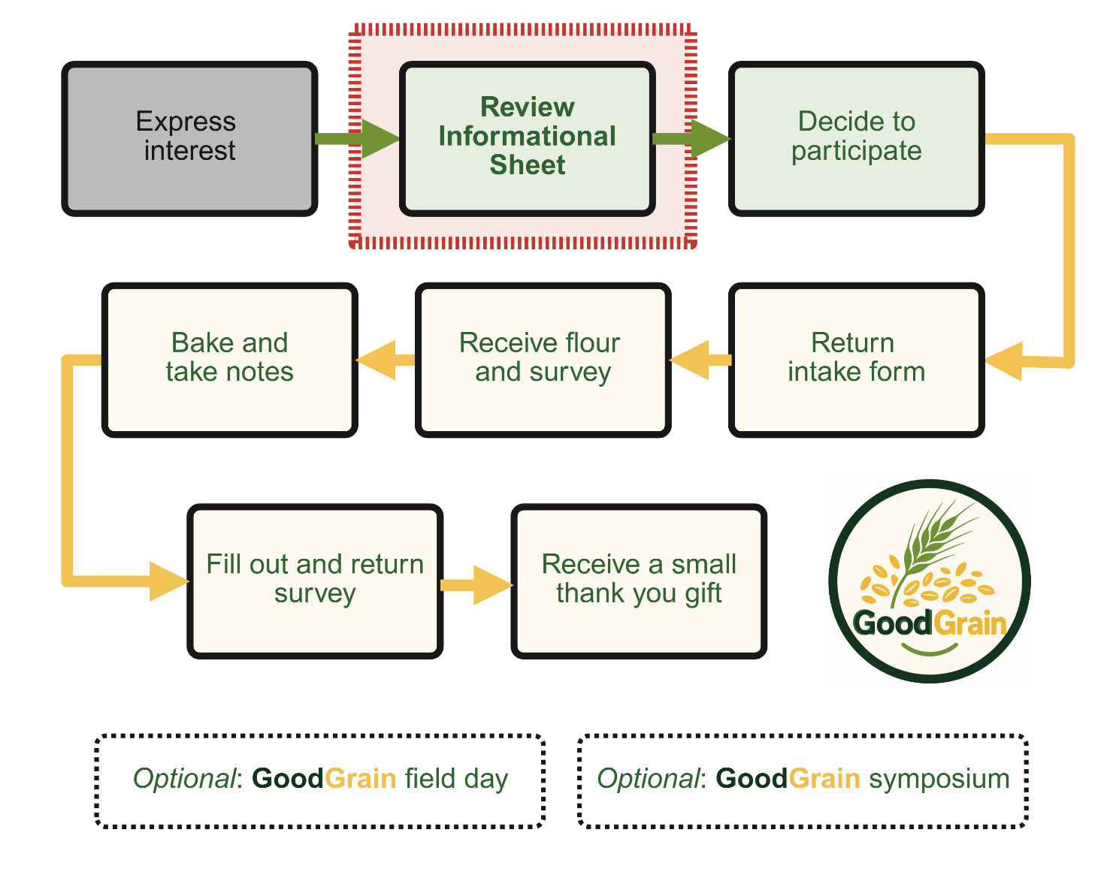
GoodGrain Home Baking Evaluation
Informational video
GoodGrain Home Baking Evaluation

Slide 2
Two videos in this series
Informational video (this one)
For the curious video
The same information is also available in an Informational Sheet
GoodGrain Home Baking Evaluation

Slide 3
This video provides:
An overview of the GoodGrain project
What is expected of you as a citizen scientist in the GoodGrain Home Baking Evaluation
Answers to some common questions
The same information is also available in an Informational Sheet
GoodGrain Home Baking Evaluation

Slide 4
Watch Informational Video
GoodGrain Home Baking Evaluation

Slide 5
An Overview of the GoodGrain Project
GoodGrain Home Baking Evaluation

Slide 6
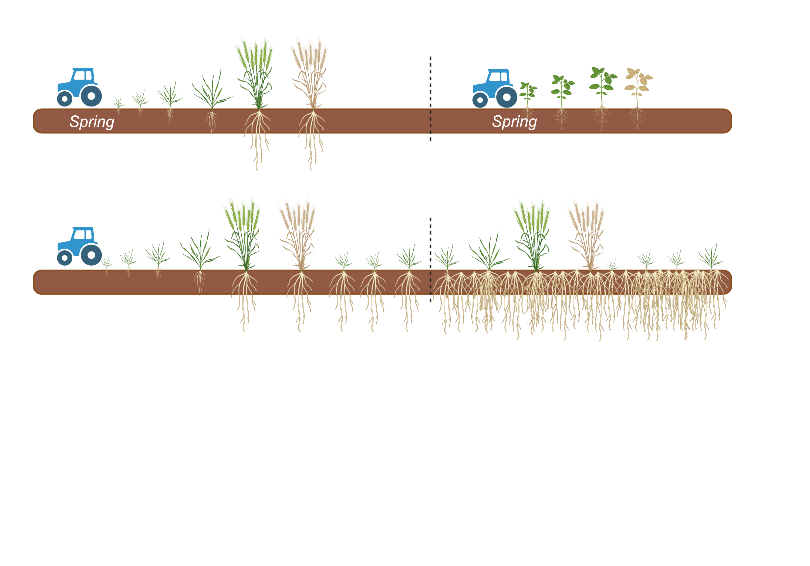
Annual grains
GoodGrain Home Baking Evaluation

Slide 7
Annual grains
Perennial grains
GoodGrain Home Baking Evaluation

Slide 8
Perennial grains
Perennial wheat
Intermediate wheatgrass (Kernza®)
Perennial rye
Perennial rice
GoodGrain Home Baking Evaluation

Slide 9
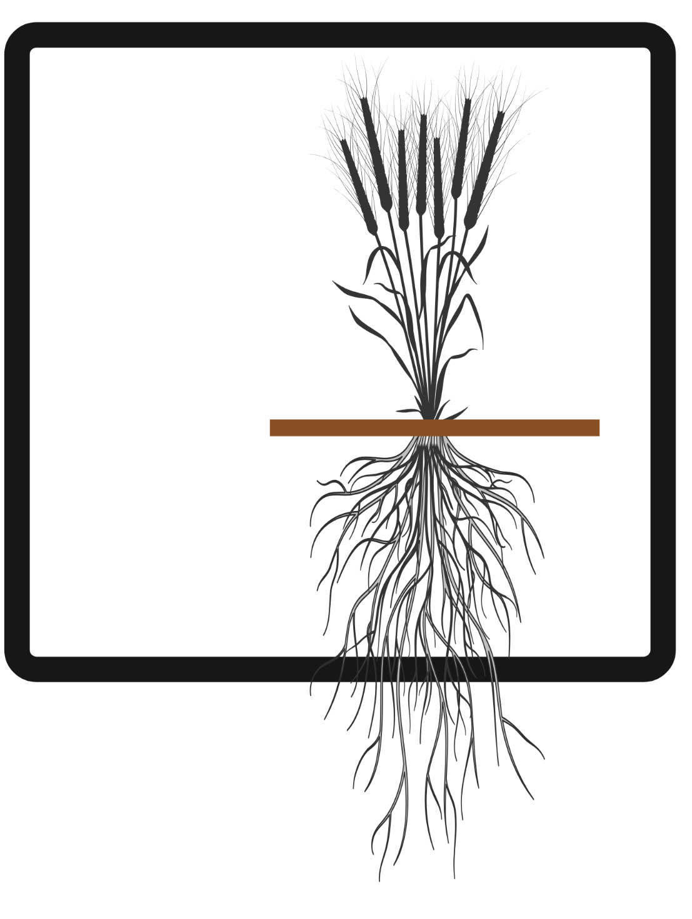
Grain
yields
Straw
yields
Nitrate
leaching
GoodGrain Home Baking Evaluation

Slide 10
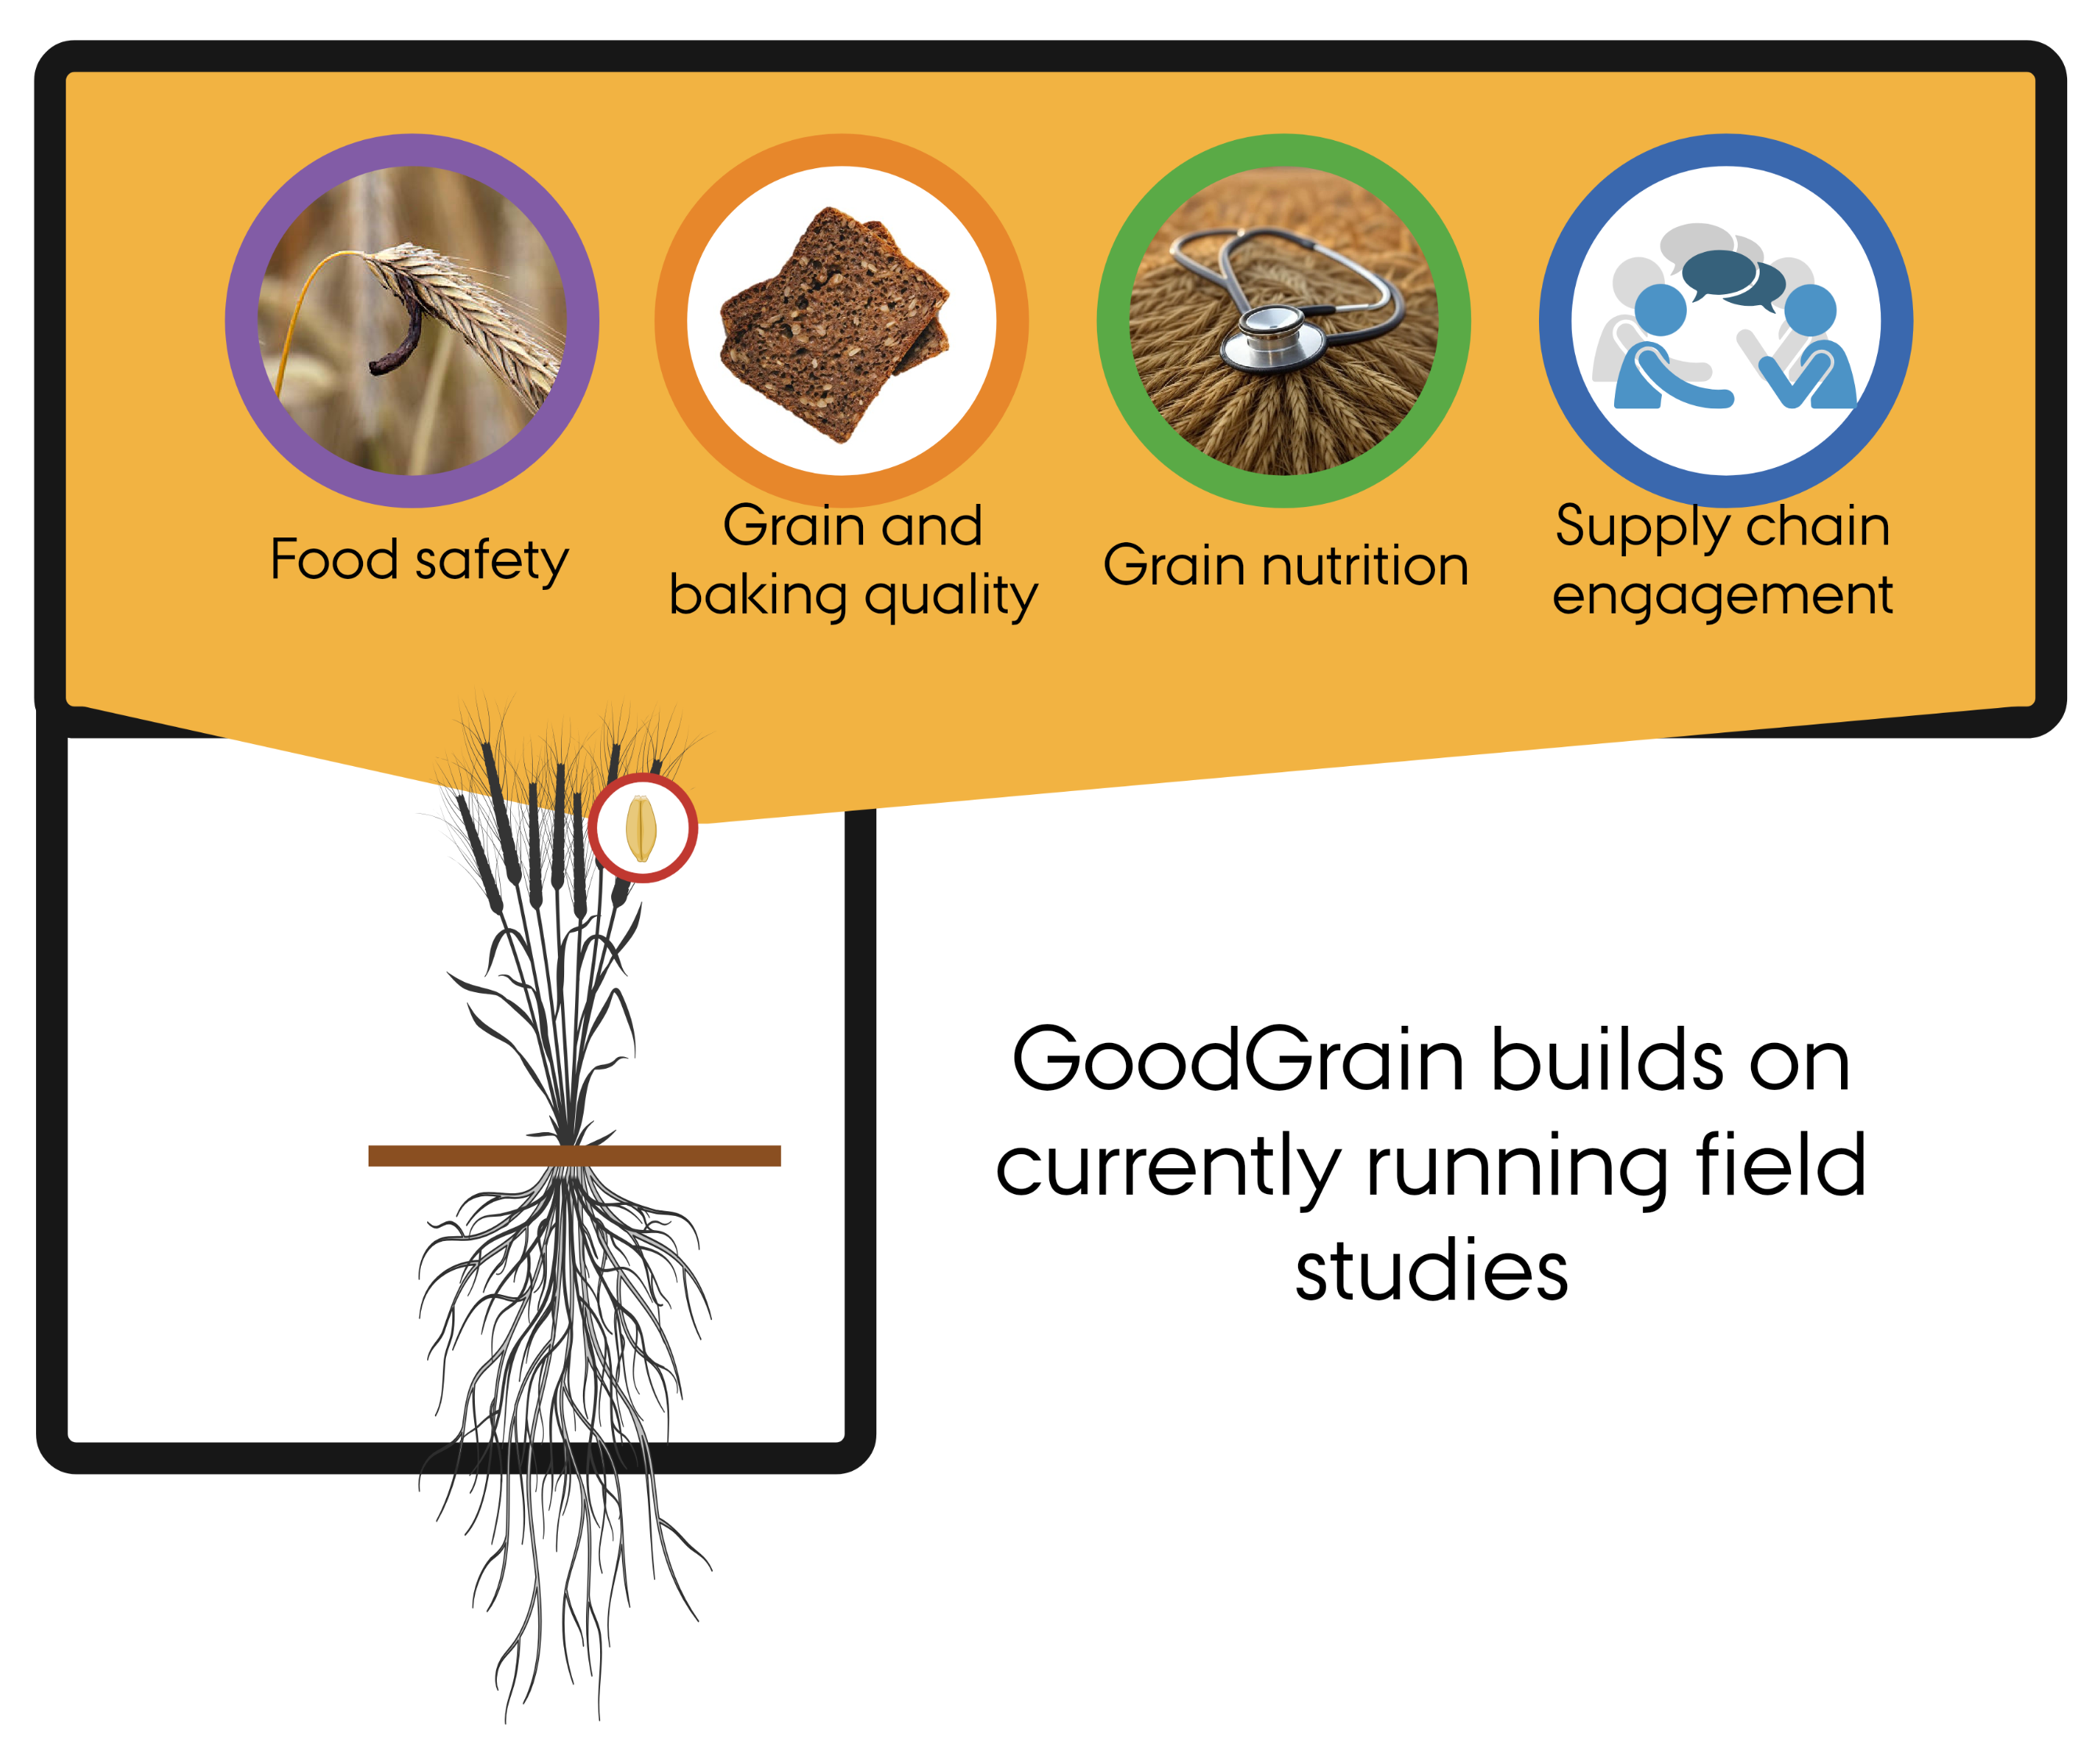
Grain
yields
Straw
yields
Nitrate
leaching
GoodGrain Home Baking Evaluation

Slide 11




Funding and project partners
This citizen science project is part of an NNF Plant2Food research project (Grant #NNF22SA0081019).
Aarhus University: Department of Agroecology and Department of Food Science
Wageningen University and Research, Netherlands
Meyers, a Danish food enterprise
More information: projects.au.dk/plant2food/funded-projects/goodgrain
GoodGrain Home Baking Evaluation

Slide 12
Why a home baking study?
GoodGrain Home Baking Evaluation

Slide 13
Why a home baking study?
Identify the best uses for this perennial rye in the home kitchen
GoodGrain Home Baking Evaluation

Slide 14
Why a home baking study?
Identify the best uses for this perennial rye in the home kitchen
Guide future research efforts
GoodGrain Home Baking Evaluation

Slide 15
Why a home baking study?
Identify the best uses for this perennial rye in the home kitchen
Guide future research efforts
Understand how people feel about baking with perennial rye
GoodGrain Home Baking Evaluation

Slide 16
What is expected of me as a participant in the home baking study?
GoodGrain Home Baking Evaluation

Slide 17
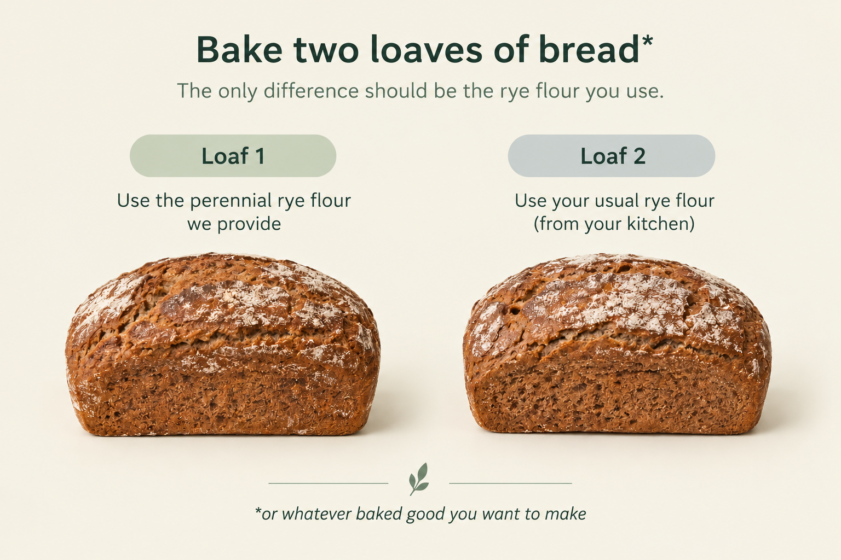
GoodGrain Home Baking Evaluation

Slide 18
Some details
Receive 400 or 800 grams of perennial rye flour (depending on your baking needs).
You will need to purchase any additional ingredients needed for your baking.
…
GoodGrain Home Baking Evaluation

Slide 19
Some details (continued)
Bake two versions, one using the perennial rye flour, one using your normal flour.
Take notes during baking.
Complete a post-baking survey
  (we estimate it will take 15-30 minutes).
Receive a small thank-you gift.
GoodGrain Home Baking Evaluation

Slide 20
Optional events
Summer 2027
Public event where you can see perennial rye growing in the field
Fall 2027
A public symposium to share information about perennial rye
Both are free and open to the public!
Attendance is optional and is not required for participation in the Home Baking Evaluation.
GoodGrain Home Baking Evaluation

Slide 21
Common questions
GoodGrain Home Baking Evaluation

Slide 22
Is this perennial rye flour safe to eat?
Yes.
The flour was tested at an independent laboratory to ensure it is safe for human consumption.
The laboratory results are available (in Danish) the GoodGrain Lab Results PDF, which you can access through the intake survey and/or the Informational Sheet website.
GoodGrain Home Baking Evaluation

Slide 23
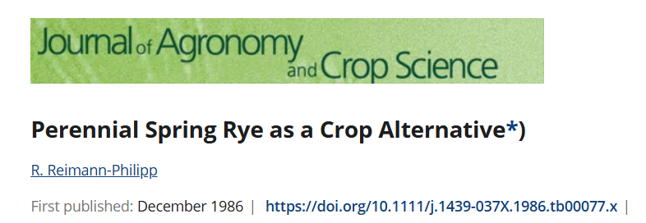
Is the perennial rye genetically modified?
No.
This variety was developed using traditional breeding methods.
Plants were crossed by hand, followed by selection based on their physical characteristics.
You can see a scientific publication from 1986 for more information:
GoodGrain Home Baking Evaluation

Slide 24
Is this grain organic?
No.
Aarhus University does not have organically certified land because of the costs and additional administrative complexity.
However, this grain was grown without the use of pesticides.
GoodGrain Home Baking Evaluation

Slide 25
Can I buy perennial rye flour?
No.
Flour from this perennial rye variety is not currently available commercially.
The project is laying the groundwork for a potential commercial release.
GoodGrain Home Baking Evaluation

Slide 26
Now you can decide
GoodGrain Home Baking Evaluation

Slide 27
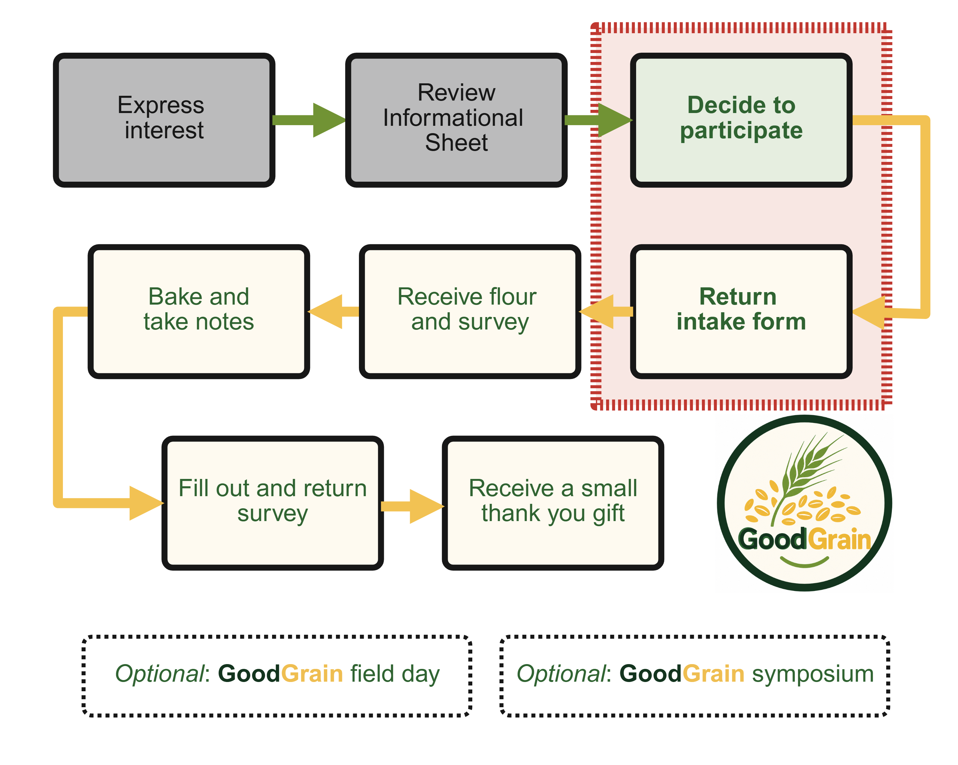
GoodGrain Home Baking Evaluation

